Slide 1
Android Developer Tools

Slide 2
Install Java Jdk
1. Download jdk
2. Java Jdk modify the installation path, it is easy to configure the environment variable。(When can follow the default installation path to install, just follow this path configuration environment variable to)
3. Click "Next"
4. Modify jre installation path，it is easy to configure the environment variable。(When can follow the default installation path to install, just follow this path configuration environment variable to)。
5. Click "Next"
6. Click "Finish"

Slide 3
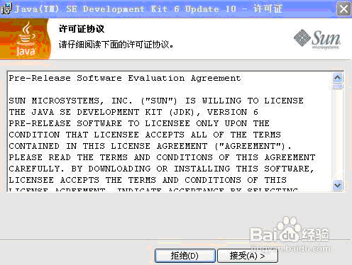

Slide 4
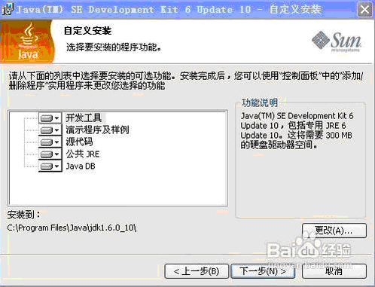

Slide 5
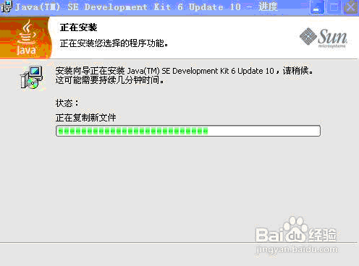

Slide 6
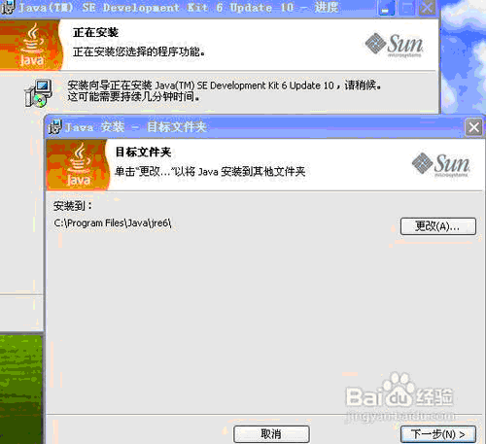

Slide 7
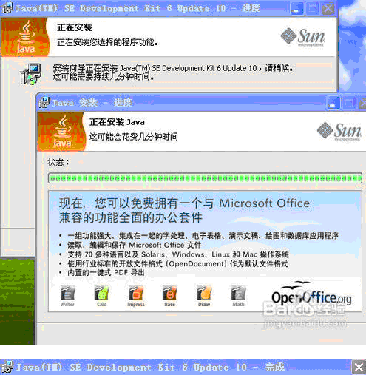

Slide 8
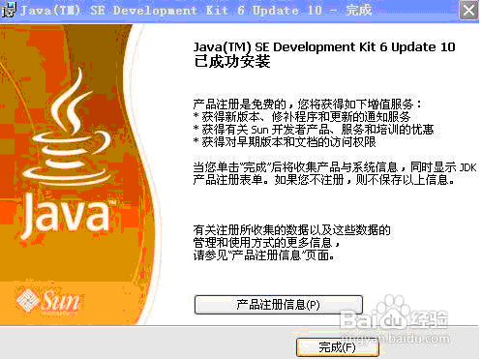

Slide 9
Configuration Java Jdk
Right-click the 我的电脑->属性->高级->环境变量->系统变量->新建(My Computer -> Properties -> Advanced -> Environment Variables -> System Variables -> New)
1：
variable name：JAVA_HOME
Variable value：C:\jdk1.6.0_10 (Self-defined installation path)
2：
variable name：classpath
Variable value：.;%JAVA_HOME%\lib;%JAVA_HOME%\lib\tools.jar
3：
variable name：Path
Variable value：%JAVA_HOME%\bin;%JAVA_HOME%\jre\bin
(Variable value if there is content with ; separated)

Slide 10
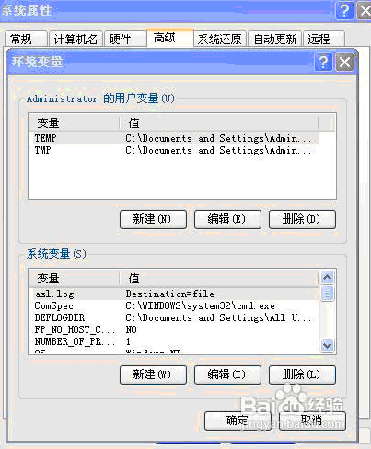

Slide 11
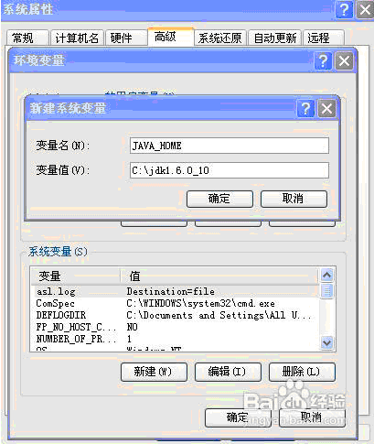

Slide 12
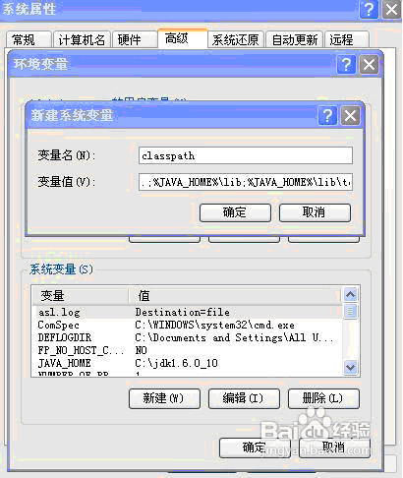

Slide 13
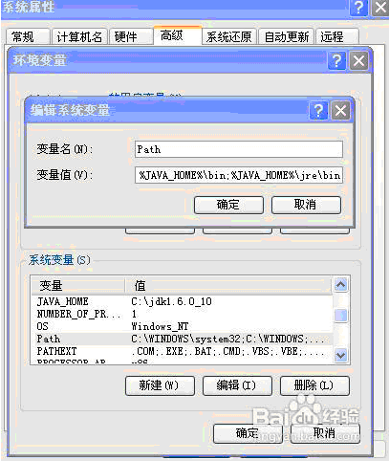
开始->运行->输入“javac”->“Enter”键，Printing can prove successful installation

Slide 14
The system environment variables configured java path is to instruct system the Java JDK / JVM installed in any place, the files configured system environment variables in the path can be accessed directly via CMD.

Slide 15
Installation and Configuration Android SDK
Installation Android SDK of SDK Manager
1：download “SDK Manager”， Loading pre-installed version of Android
2：Click Install 4 packages
3：Select “Accept”，click “Install”
4：Select the pre-installed version of Android, to start the installation。And install “tool”、“Extras”。
5：Others are carried out in accordance with the default installation。

Slide 16
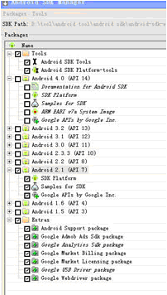

Slide 17
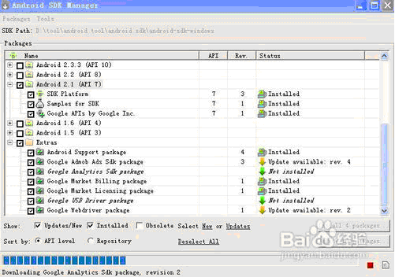

Slide 18
Eclipse Install Developer Tools Widget
Enter eclipse main interface
1：Click help->Install New SoftWare->Add
Name：Any alphabetic character
Location：https://dl-ssl.google.com/android/eclipse/
2：Finished loading “Developer Tools”。
3：Next
4：Select “I accept the terms of the license agreements”，Click “Finish”
5：Wait for the installation。
6：Click “OK”
7：If you have additional tips, please follow the default installation。

Slide 19
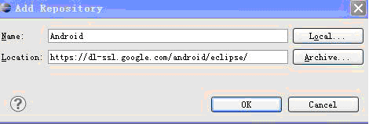

Slide 20
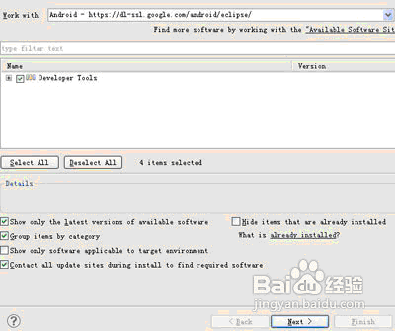

Slide 21
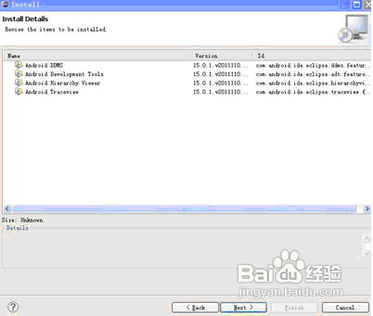

Slide 22
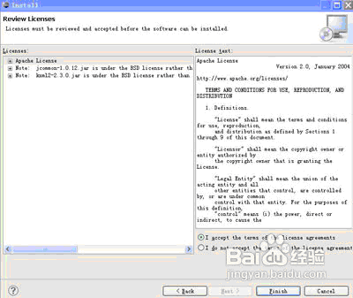

Slide 23
